Slide 1
EtherCAT
The real-time Ethernet fieldbus

Slide 2
What is EtherCAT?
EtherCAT(Ethernet for Control Automation Technology)
is the open real-time Ethernet network protocol.
Open technology - anyone is free to use the technology in a compatible form.
Fastest Industrial Ethernet Standard (short cycle times ≤ 100 µs), low jitter for accurate synchronization (≤ 1 µs), low cost and ease of use.
EtherCAT technology group promotes EtherCAT and is responsible for its continued development.

Slide 3
History & Roadmap
Developed by Beckhoff Automation GmbH & Co - German company
2003 - Presentation of EtherCAT technology at the Hanover Fair
First EtherCAT devices: I/O terminals, encoders, drives
Contribution to IAONA, submission for IEC standardization
First pilot applications in Schuler presses
2004 - First EtherCAT Technology Group conference in Frankfurt
Completion of the EtherCAT specification (2nd/3rd quarter)
Disclosure of the EtherCAT protocol (3rd quarter)
Delivery of a first EtherCAT communication ASIC (4th quarter)
2004 - The technology won the North America “Engineers’ Choice Awards“
2007 - EtherCAT became an international standard under IEC 61158

Slide 4
How it works
EtherCAT’s key functional principle lies in how its nodes process Ethernet frames: each node reads the data addressed to it and writes its data back to the frame all while the frame is moving downstream. This improves bandwidth utilization (one frame per cycle is often sufficient for communication) while also eliminating the need for switches or hubs.

Slide 5
Why use EtherCAT?
Exceptional performance - fastest Industrial Ethernet technology, synchronizes with microsecond accuracy
Flexible topology - line, tree, star topologies and any combinations thereof are possible with nearly unlimited number of nodes
Simple and robust - Uses same type of connectors and cables as ethernet. EtherCAT can be set to automatically to assign addresses. During startup, the network compares the planned and actual layouts to detect any discrepancies

Slide 6
“Contd”
Integrated Safety - FSoE (Fail Safe over EtherCAT) is proven in use through TUV certified devices that have been on the market since 2005
Affordability - Only hardware required by the master device is an Ethernet port - no expensive interface cards or co-processors are necessary

Slide 7
OSI & EtherCAT
OSI | EtherCAT
Application | Data Exchange
Presentation | ------------------
Session | ------------------
Transport | ------------------
Network | ------------------
Data Link | EtherCAT MAC
Physical | EtherCAT Physical Layer

Slide 8
Features
Communication | Ethernet Cabling (CAT5, CAT6)
Topology | Ring, Tree, Line, Star, Bus, Hybrid
Duplex | Full-Duplex
Data Rate | 100 Mbps
Distance | 100 m (Ethernet), 20 Km (Fiber Optics)
Client | 65,535

Slide 9
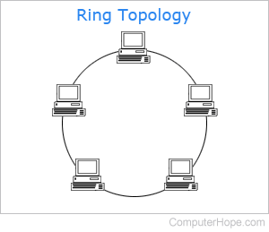
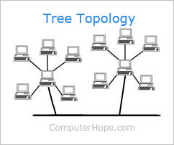
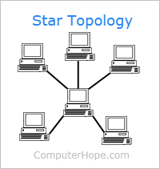
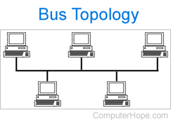
Topology
65,535 Devices/Nodes per Net (Practically Infinite)
Full Duplex
Versatility Offers many topologies
  Star, Line, Ring, Tree, Bus, Hybrid

Slide 10
EtherCAT Applications
Robotics
machine tools
packaging machinery
printing presses
plastic manufacturing equipment
presses
semiconductor manufacturing machines
test benches
pick and place machinery
measurement systems
power plants
substations
material handling applications
baggage handling systems
stage control systems
automated assembly systems
pulp and paper machinery
tunnel control systems
welding machinery
cranes and lifts
farm machinery
offshore applications
sawmills
window manufacturing equipment
building automation systems
iron and steelworks
wind turbines
furniture manufacturing equipment
milling machinery
automated guided vehicles
entertainment automation
medical devices
woodworking machinery
flat glass manufacturing equipment
weighing systems
and many more

Slide 11
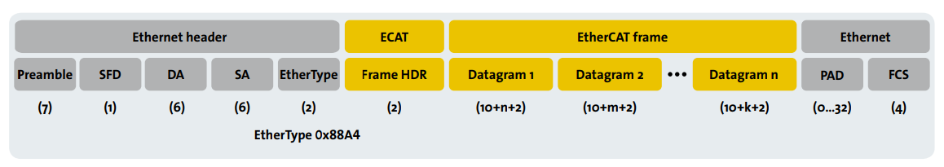
EtherCat Frame

Slide 12
Ethernet Header
Preamble: It allows the receiver to synchronize with the timing of the received data, It helps the receiver to detect the beginning of the frame.
SFD(Start Frame Delimiter): It is used to indicate the start of a new frame.
Destination Address (DA): The Destination Address field specifies the address of the device intended to receive the EtherCAT frame.
Source Address (SA): This field indicates the address of the device that transmitted the EtherCAT frame.
Ether Type: This field indicates the protocol type of the payload data encapsulated within the frame devices can determine the used protocol and process it.

Slide 13
ECAT Frame
Frame HDR: The frame header contains essential information about the frame, including its type, length, and other control flags. The specific fields within the frame header includes:
Frame Type: Indicates the type of EtherCAT frame, such as data frame, acknowledge frame, or error frame.
Frame Length: Specifies the length of the frame, including both the header and payload.
Flags: Control flags indicating additional information about the frame, such as whether it contains process data or control information.
Datagram: This section of the frame carries the actual payload of the communication. It consists of one or more data segments, each containing information such as process data, control commands, or status updates. The structure and content of the data depend on the specific application and the devices involved in the communication.

Slide 14
Pad: The padding field consists of additional bits (typically zeros) added to the end of the frame to increase its length. It helps to ensure the integrity of data transmission by maintaining the minimum frame length required for collision detection and network reliability.
FCS(Frame Check Sequence): It is used to detect and correct errors that may occur during transmission.
Ethernet

Slide 15
Ethernet Vs Ethercat
(Topology difference)
Ethernet - bus topology
EtherCat - Daisy-chain topology

Slide 16
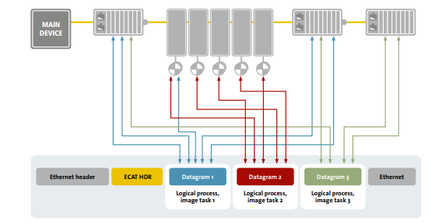
Working of an EtherCat Frame in Daisy-chain topology.

Slide 17
Limitations
Complex setup: not easy to set up, requires expertise and experience.
Compatibility issues: inoperability between devices from different manufacturers.
Daisy-chain topology: often delays in large/complex networks are inevitable.
Single master device: If the master device fails then the entire network will fail.
Determinism: Determinism degrades in the large networks.
Limited diagnostic tools: Identifying and resolving errors requires specialised expertise. Also, the number of diagnostic tools are limited.

Slide 18
EtherCAT P | EtherCAT G
POE + EtherCAT Standards
Power gets sent with Data
One cable for power
  Sensors, Actuators
Special M8 Connectors
Cost-Effective
Compact
Gigabit EtherCAT
  1 Gbps
IEEE 802.3 Compatible
Compatible with all pre-existing EtherCAT systems
Focuses on branches
  EtherCAT Branch Controllers (EBC)
EBCs act as nodes for individual segments

Slide 19
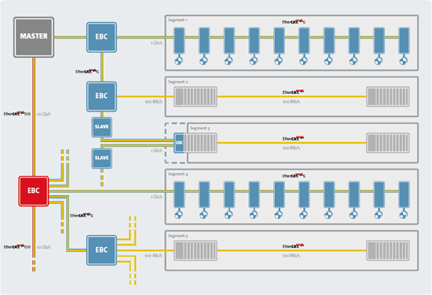
EtherCAT G

Slide 20
YouTube videos

Slide 21
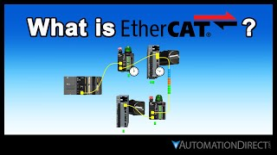

Slide 22
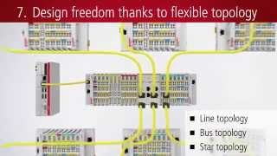

Slide 23
References
https://en.wikipedia.org/wiki/EtherCAT
https://www.ethercat.org/default.htm
https://dewesoft.com/blog/what-is-ethercat-protocol
https://www.beckhoff.com/en-en/products/i-o/ethercat-p/?pk_campaign=AdWords-AdWordsSearch-ethercat_P_EN&pk_kwd=ethercat%20p&gad_source=1&gclid=CjwKCAjwi_exBhA8EiwA_kU1MrE_sXjWdTFjA-bqhfcIQ0wlIJyqAoVIfH2kQoVpgm8j9UrXUj33zBoCT3gQAvD_BwE

