Slide 1


RAPIEnet Protocol

Slide 2
What is RAPIENET?
RAPIEnet, which stands for Real-time Automation Protocols for Industrial Ethernet, is an industrial ethernet protocol created by South Korean firm LS Industrial Systems (now LS Electric) in the year 2008, and had additional standards incorporated in 2010.
The protocol is designed to provide real-time communication and allow for seamless addition of devices onto a network.
This protocol was Korea’s first internationally recognized standard.

Slide 3
RAPIENET Standards
IEC 61784-2 CPF 17, 61158-3-21, 61158-4-21, 61158-5-21, 61158-6-21, 62439-7
These standards are unfortunately inaccessible without paying to view them, and one of them has since been withdrawn as a standard
Details are unfortunately quite sparse regarding them

Slide 4
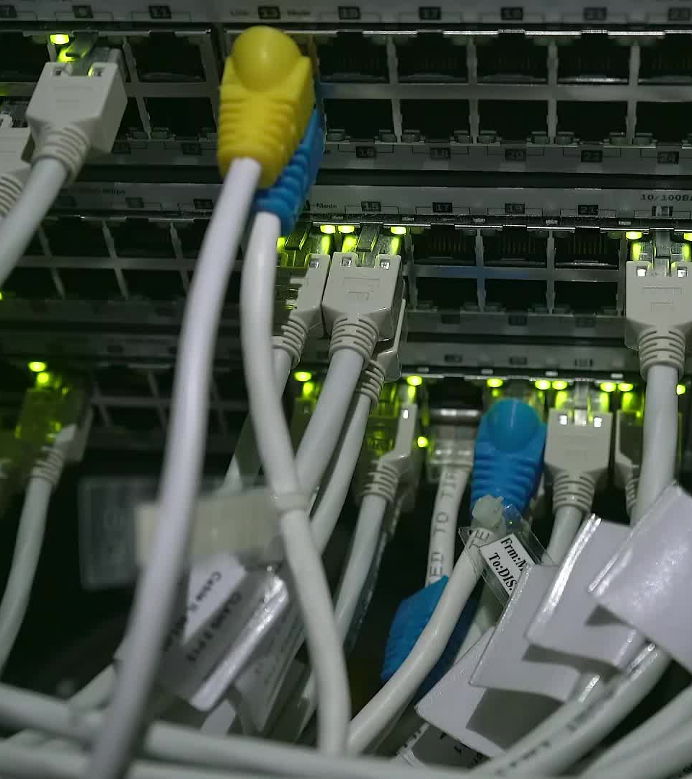
RAPIENET Features
The RAPIEnet protocol is designed to work between speeds of 100 Mb/s and 1 Gb/s.
It can use both Optical and traditional Ethernet cabling to facilitate data communication.
It allows for the use of Unicast, Multicast and Broadcast for transmission.
RAPIEnet is designed to have a downtime of 10ms or less thanks to its embedded switching capabilities, and has even purportedly hit 8ms times.
It is designed to work in both Line and Ring type topologies
Uses CSMA/CD protocol and works with up to 64 devices.
Notes:
Various functions for network monitoring and diagnosis
Which allows for more noise reduction with fiber optic and cheaper wiring for electronic to maximize cost effectiveness
RAPIEnet supports ring and line network topologies. When a network is changed from ring to line topology, or vice versa, the change is automatically detected and broadcast to every device in the network, and network information and path table entries are then automatically updated
Because of the limited number of ports in a RAPIEnet switch, this processing time is significantly reduced in comparison to traditional multiport external switches. RAPIEnet nodes can be divided into multiple groups, and each group can perform independently. If a frame is designated for another device in a particular group, the current node forwards the frame at the medium access control level, thus avoiding upper layer delays.

Slide 5
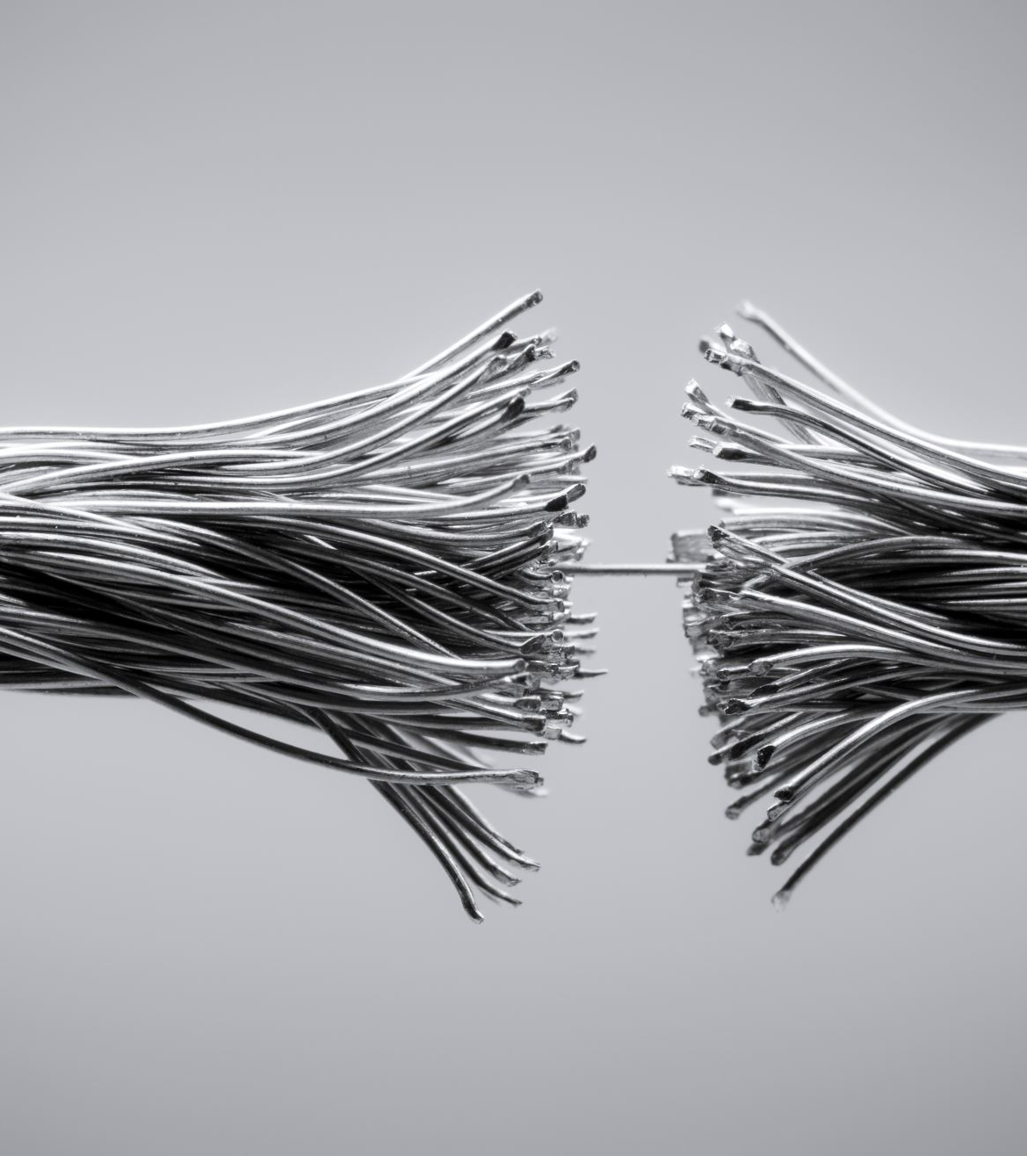
RAPIENET CABLING
RAPIEnet supports 3 different cabling types for its tradtional ethernet cabling, USTP, STP, and FTP.
Fibre optic cabling is used for its Optical solutions

Slide 6
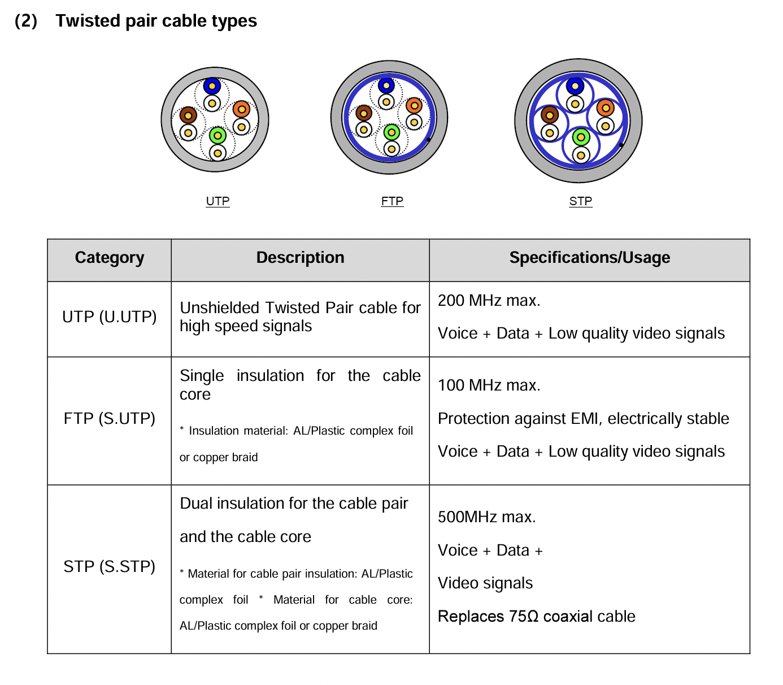
CABLING EXAMPLES

Slide 7
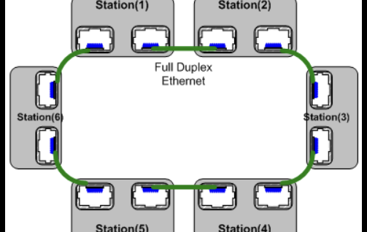
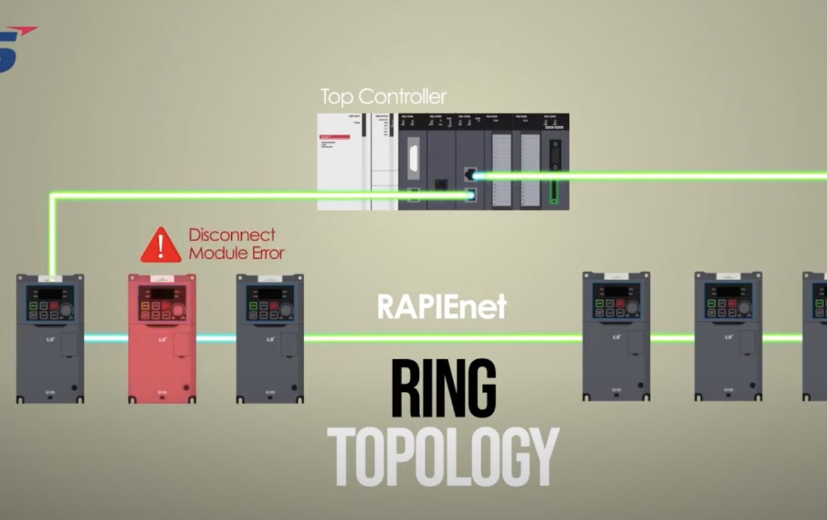
RapieNet TOPOLOGy examples(RING)
RAPIEnet becomes especially relevant when discussing its advantages where it is applied in ring topologies.

Slide 8
Main benefits of RapieNet
RAPIEnet’s major design point was to be a protocol made for people who did not understand the inner workings of the ethernet system and didn’t have the ability to fully integrate. The major feature of RAPIEnet devices and protocols is that it can be adapted into existing ethernet structure and thanks to its auto-negotiation capabilities it is able to seamlessly integrate into new systems.
This adaptability is because RAPIEnet does not completely differ from the ISO/IEC 8802-3:2000 standard, and instead builds on the concept, which allows for the protocol to be used on ethernet without incurring changes on infrastructure.

Slide 9
MAIN Benefits of RAPIEnet
Along with the auto negotiation, RAPIEnet boasts impressive reliability and redundancy capabilities. This is built on the auto-negotiation. When the system suffers a break in its ring topology, it will immediately move to a line topology and update the system in 10ms or less, while allowing simultaneous communication in both directions at the same time up to point of where the fault occurred, removing the need for manual oversight to restore partial connectivity. The use of CSMA/CD and full-duplex communication supports the auto-negotiation to allow for this.
RAPIEnet provides two-way communication, optimal path selection automatically, and two types of switching methods (cut-through and store & forward) to reduce propagation delay and high-availability.

Slide 10

RAPIENET REQUIREMENTS and FRAME FORWARDING
The main component that is needed for devices using the RAPIEnet protocol to function is an integrated switch connected to 2 ports (this is the minimum number of ports needed).
Due to the need of an integrated switch, the necessity of an external switch to facilitate the movement of data becomes irrelevant.
This integrated switch handles operations above the RAPIEnet Data Link Layer during the frame forwarding process to reduce processing time, while allowing the Data Link Layer to remain unaffected by processing time during the transmission.

Slide 11
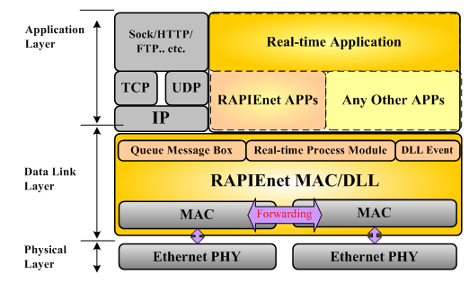
Protocol Layers
RAPIEnet is a 3 layer protocol consisting of the Application, Data Link, and Physical layers. Since the protocol is using Ethernet as its basis, it is usable with TCP/IP and UDP/IP.
The majority of the frame is used by the RAPIEnet protocol for use of Real-time transmission.

Slide 12
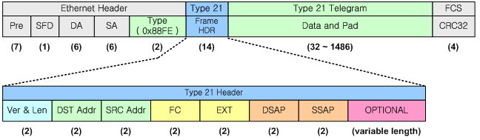
RAPIEnet FRAME
RAPIEnet consists of a 4 part frame. The first part is the ethernet header, then followed by a separate type 21 header which contains the Version and Length of the data, Start Frame Delimiter Destination Address, Source Address, Function Code, Extension, DSAP(Destination Service Access Point), SSAP(Source Service Access Point), and an optional field, the third part consists of the actual data, and the final part is a CRC32 type error check which hashes byte sequences to 32 bit values specifically using polynomial division.
RAPIEnet’s used Ether type is: 0x88FE

Slide 13
Use cases for RAPIENET
Currently, RAPIEnet is being used in many industrial sectors to speed up production times and processes.
Key industries are the automotive industries including car manufacturing, which it has been able to contribute heavily to.
Another industry serviced is the the chemical control field

Slide 14
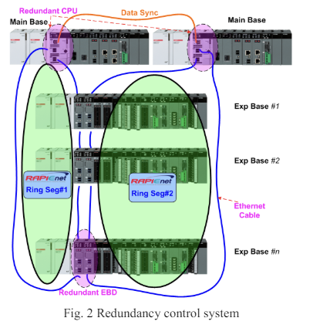
USE CASES FOR RAPIENET Cont.
RAPIEnet can also be used to create a redundant network as explored by the team of Geon Yoon, Soo-Gang Lee, Dae-Hyun Kwon, Soon-Chang Kwon, and Yong-Oon Park, who were able to create a fully redundant network using the ring topology as a base.
Utilizing the RAPIEnet ring topology as a backbone, they were able to create redundant architecture that can quickly restore network connectivity in full thanks to the auto-negotiation properties of RAPIEnet.

Slide 15
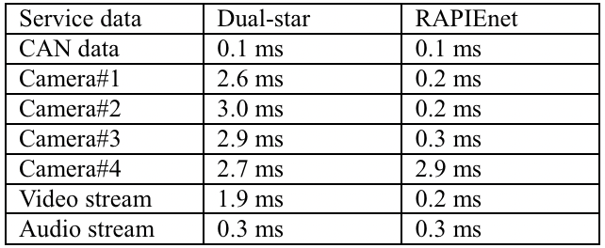
USE CASES FOR RAPIEnet cont.
Additionally RAPIEnet has also been theorized to be a better use case for an application in the networks of cars, not just their manufacturing.
A study by Dae Hyun Kwon and John Seok Oh found that a RAPIEnet ring topology can communicate faster than a dual star network topology in use as of 2012.

Slide 16

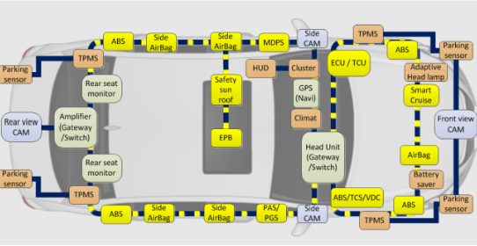
Real world use
Used at Hyundai Motors and Gwangju Global Motors (GGM)

Slide 17
Potential downsides of RAPIENET
Due to the nature of the protocol, RAPIEnet’s downsides are not readily apparent, however there are potential problems with 2 specific factors
The use of CSMA/CD in the ethernet protocol which RAPIEnet uses does inflict potential time losses on the network, this is lowered due to RAPIEnet’s usage of topology, but it is still a concern.
The other concern is the protocol’s length in terms of distance, as unless you are using optical communication, the distance limitation of 100 meters may be too restrictive.

Slide 18

RAPIENET+
RAPIEnet+ is the latest version of RAPIEnet technology released in 2021.
It is an IEC-approved industrial Ethernet protocol, and its device-specific options aid in the use of smart factory data. This ensures connectivity among products through the application of independent communication protocols.
It is marketed as an all-in-one solution that simultaneously supports the three industrial Ethernet technologies of RAPIEnet, Mod-bus TCP, and EtherNet/IP as well as OPC-UA while enabling up to 1Gbps bandwidth connections.
Allowed LS Electric to substitute major production line equipment in the automobile and semiconductor industries in Korea.
Allows for the use of the star type topology

Slide 19
videos
https://www.youtube.com/watch?v=aOCrq-9eswo
https://www.youtube.com/watch?v=f20hvnrabBk
https://www.youtube.com/watch?v=jtOj_WBwDTE

Slide 20
REFERENCES
https://www.ls-electric.com/products/view/Smart_Automation_Solution/PLC/Smart_I!O_Series/Smart_IO_Series
https://woosuklee.com/portfolio-item/iec-standardization/
https://ieeexplore.ieee.org/document/6106394
https://ieeexplore.ieee.org/document/6393490
http://procon.co.kr/pdf/2014%2012/1-01.pdf

Slide 21
REFERENCES CONT.
https://fuchsia.googlesource.com/third_party/wuffs/+/HEAD/std/crc32/README.md#:~:text=CRC%2D32%20(Cyclic%20Redundancy%20Check,of%20polynomials%20can%20be%20used.
https://en.wikipedia.org/wiki/RAPIEnet
https://dl.plc1.ir/manual/ls/vfd/is7/IS7_RAPIEnet_Plus_Option_User_Manual_Kor_Eng_V1.00_200707_new.pdf
https://www.lsholdings.com/en/media/news/6e6e684f586a725850457048427361775933364f7777586c5736694a36484e4f
https://sol.ls-electric.com/uploads/document/16947552908120/RAPEInet%20plus_Catalog_EN_202303.pdf

